Slide 1
2-bit Branch Predictor
EE-475L Computer Architecture
(Complex Engineering Problem)
Group VI

Slide 2
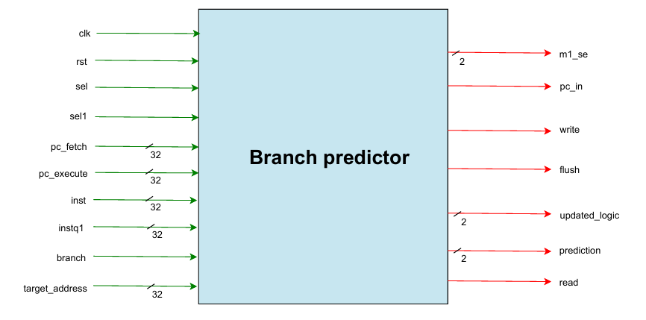
Branch Predictor Diagram

Slide 3
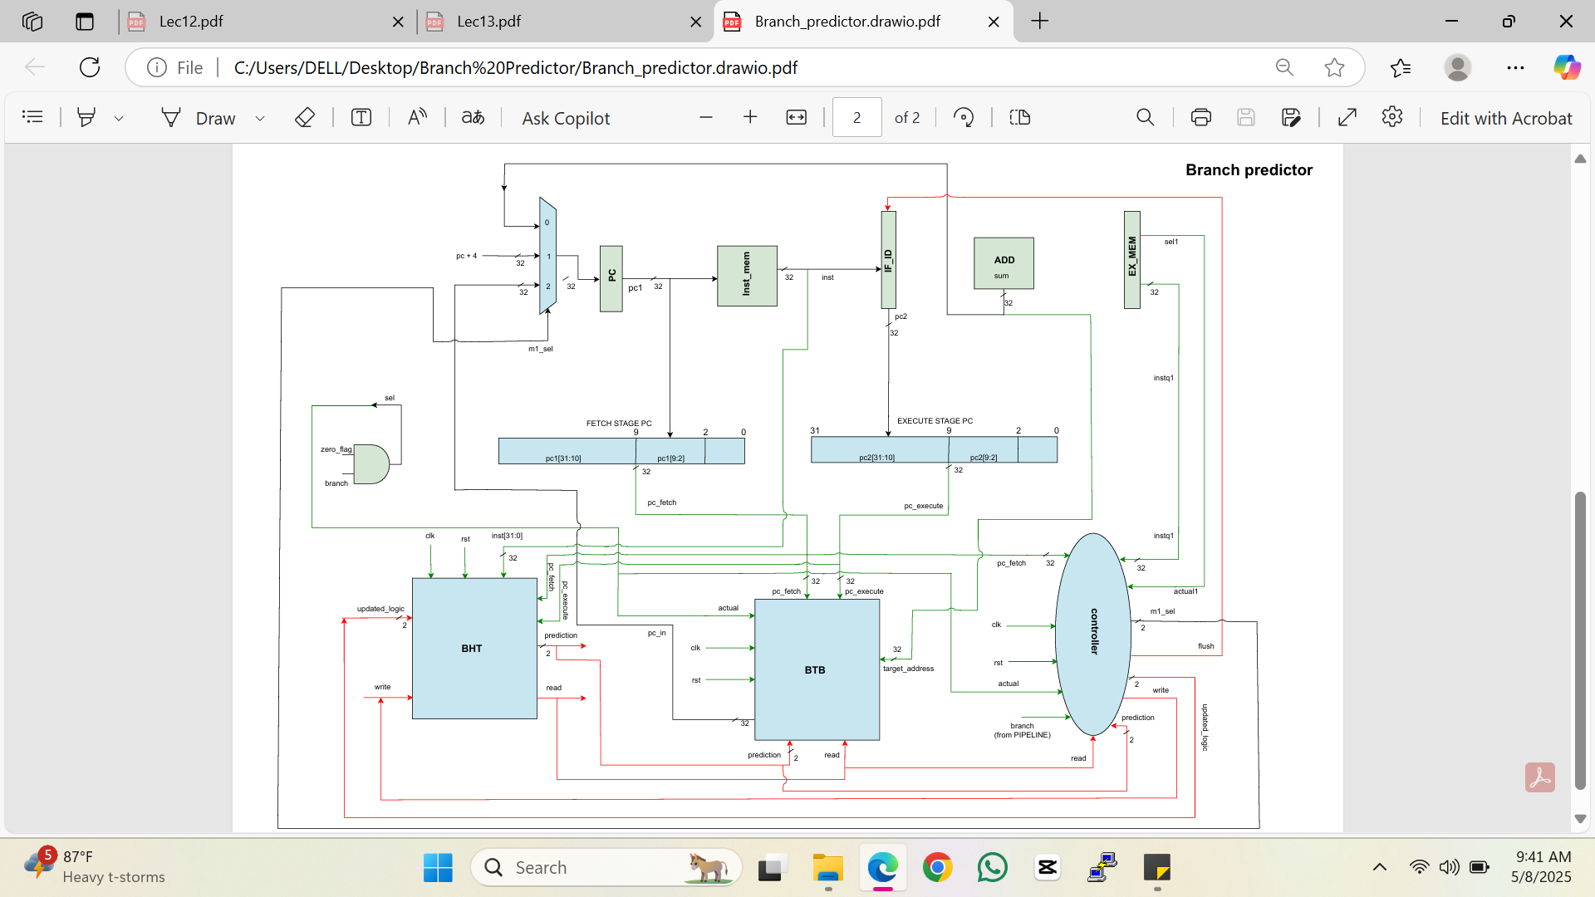

Slide 4
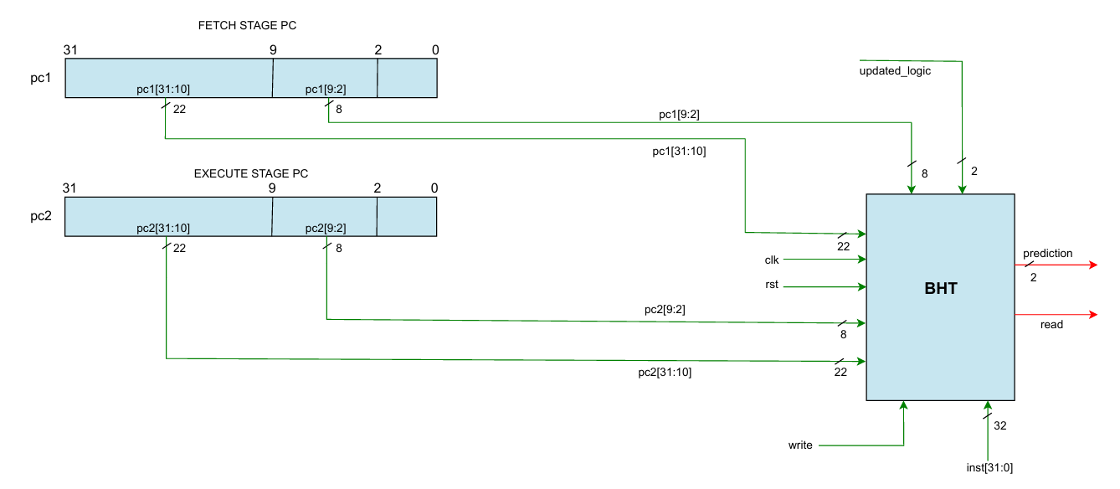
BHT Diagram

Slide 5
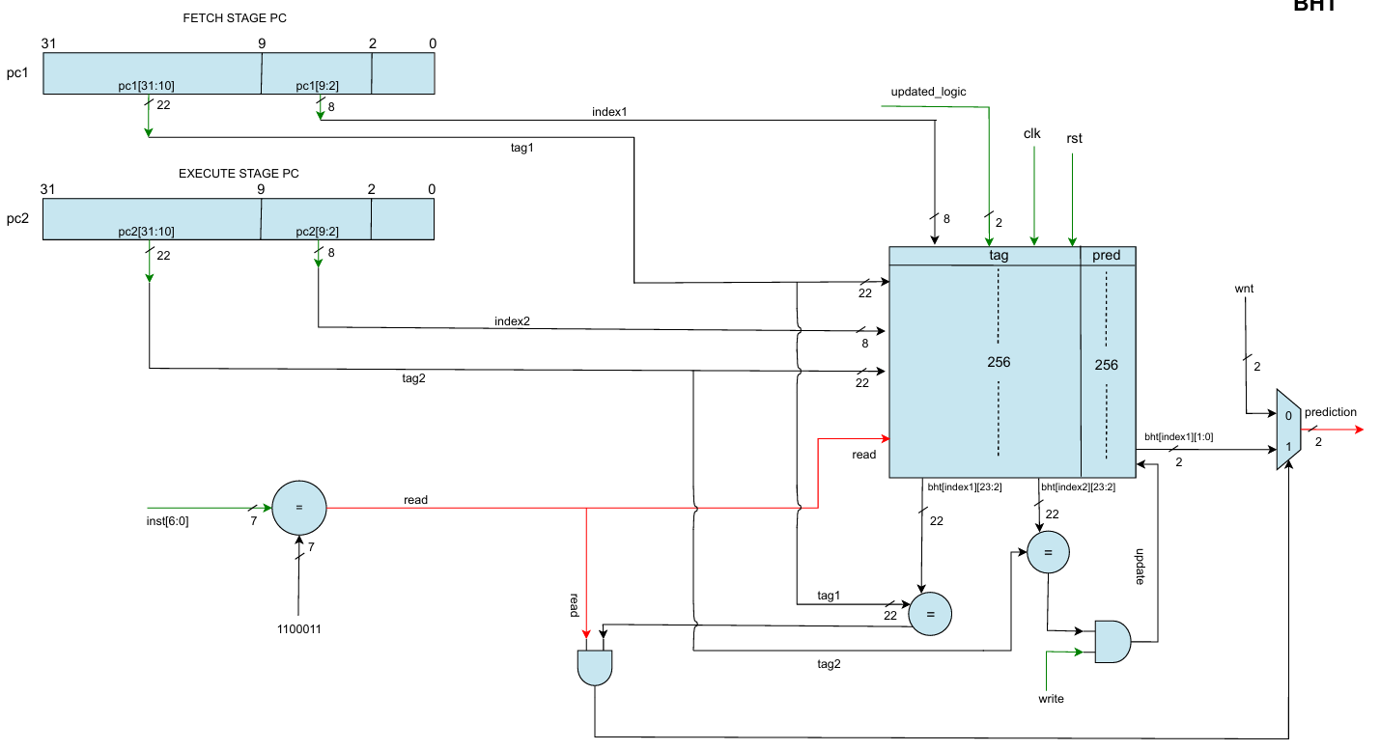
BHT Diagram

Slide 6
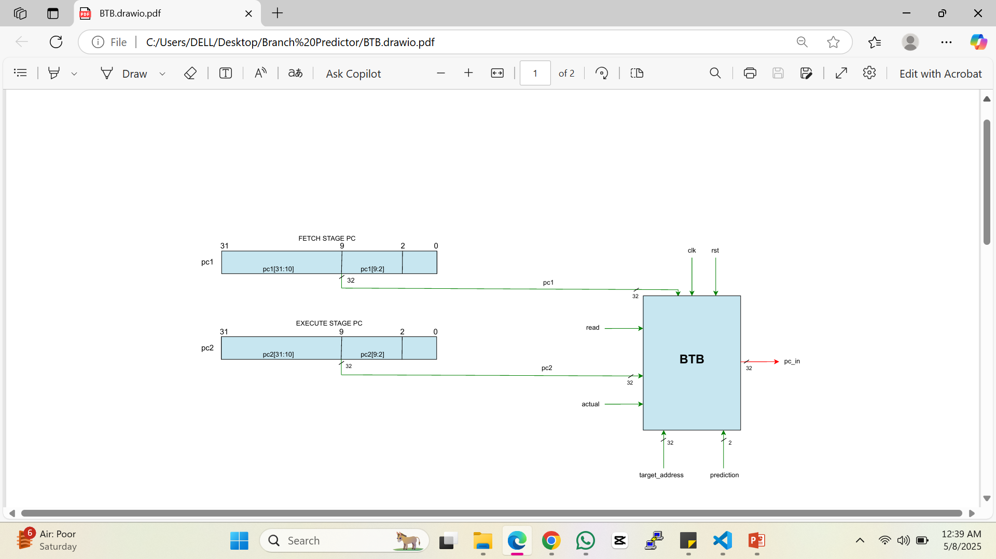
BTB Diagram

Slide 7
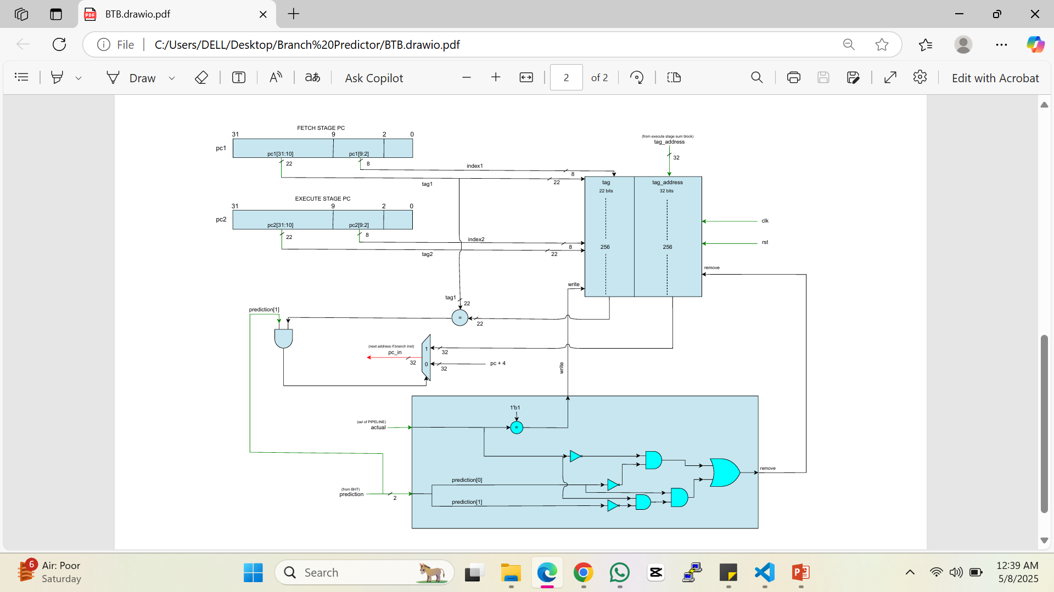
BTB Diagram

Slide 8
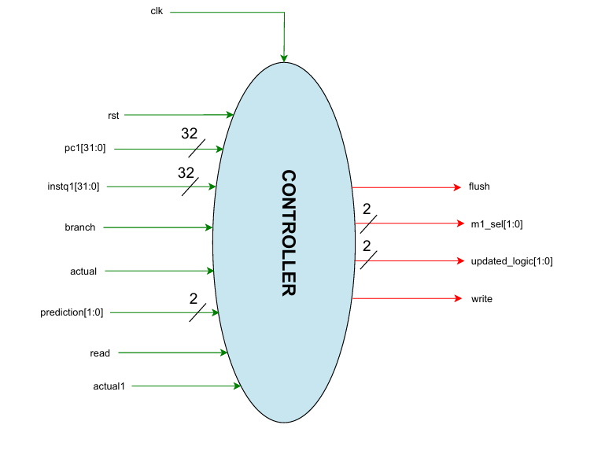
Controller Diagram

Slide 9
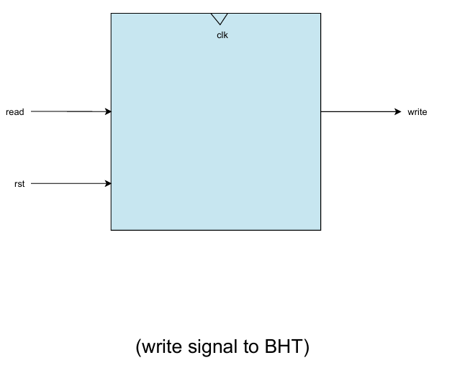
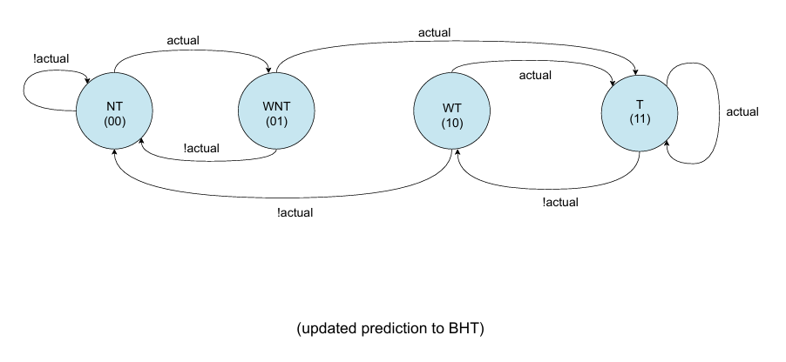
Controller Diagram

Slide 10
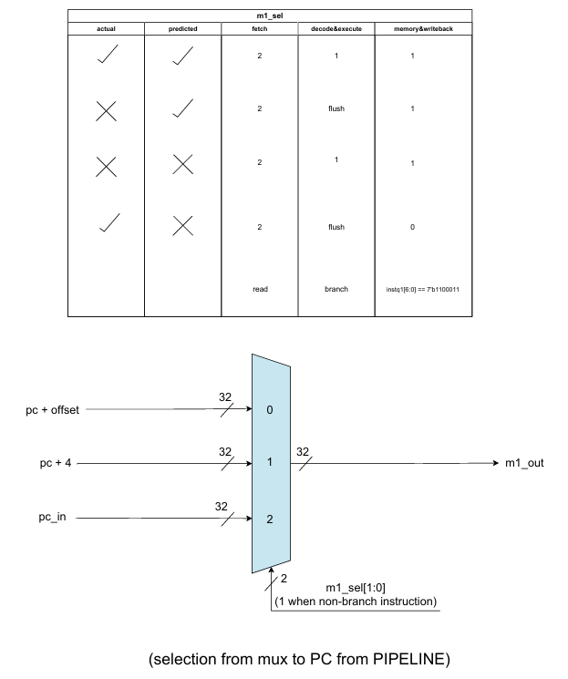
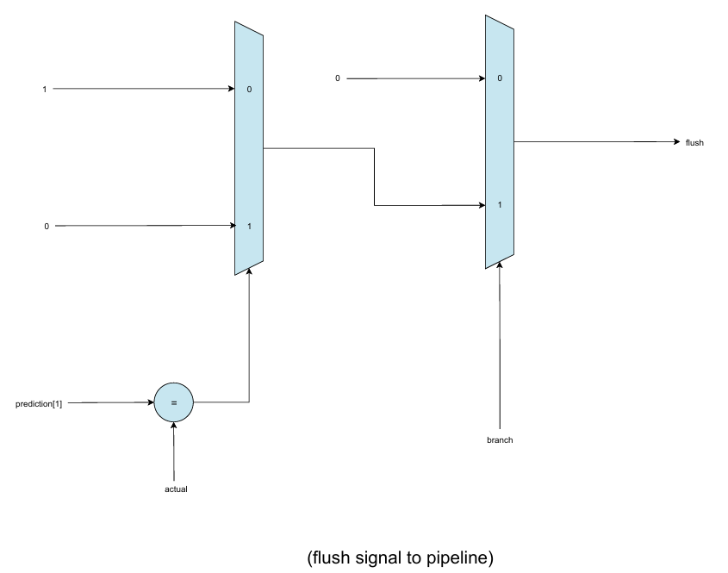
Controller Diagram

Slide 11
Expected Goals
Stage 1:
Design a 2-bit branch predictor (BHT, BTB, Controller)
Stage 2:
Implement the branch predictor designed
Stage 3:
Test seamless coordination between BHT, BTB and Controller along with their functionality independently and combined.

Slide 12
Achieved Goals
Stage 1:
2-bit forward prediction architecture designed.
Stage 2:
Fully functional BHT, BTB and controller architecture implemented.
Stage 3:
Simulated the architecture with multiple branch patterns.

Slide 13
Algorithm
Prediction (Fetch stage):
If branch inst, use PC to access BHT and BTB.
BHT gives a 2-bit prediction (NT, WNT, WT, T).
If taken, BTB provides the target address. Else, BTB provides pc+4.
Decode/Execute Phase:
Actual result is known now so compare actual outcome with predicted one.
Update BHT: Adjust internal counter (Increment if branch is taken and decrement if not taken)
Update BTB: On actual taken branch, save target address ensuring fast access for next prediction

Slide 14
Results
Simulation of branch instruction,
0x00018a63
Whose target address = 0x0000014
With the pattern
A non-branch instruction at the end to validate our architecture works only for branch instructions.
Actual | Taken | Taken
Predicted | Weakly Not Taken | Taken
 | X | ✓

